Slide 1
Mechanisms and determinants of tau spreading in Alzheimer‘s disease
Dr. Nicolai Franzmeier
Alzheimer’s disease Neuroimaging Group

Slide 2
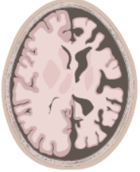
Alzheimer‘s disease – A cascade of pathological brain changes
Abnormal
Progression of primary
AD pathology
Amyloid
Dementia
Tau
Reserve & Resilience
Coping with pathology
MCI
Normal
Cognitively
Normal
Time
Jack et al. Lancet Neurol, 2013

Slide 3
Alzheimer‘s disease – A cascade of pathological brain changes
Abnormal
PET-imaging &
Biomarkers
Progression of primary
AD pathology
Amyloid
Dementia
Connectomics
Tau
Reserve & Resilience
Coping with pathology
MCI
Normal
Cognitively
Normal
Genetics
Time
Jack et al. Lancet Neurol, 2013

Slide 4

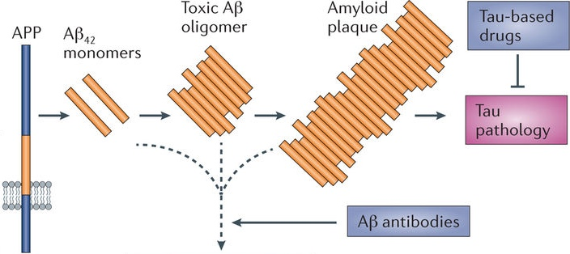
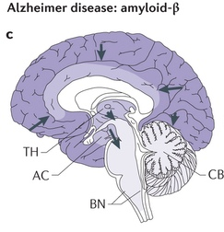
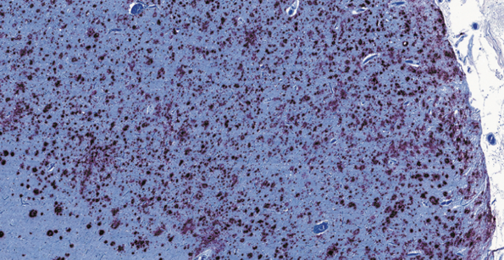
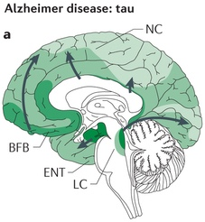
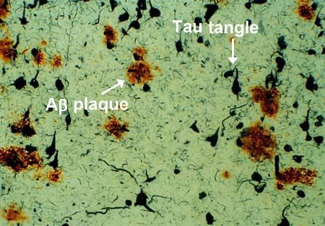
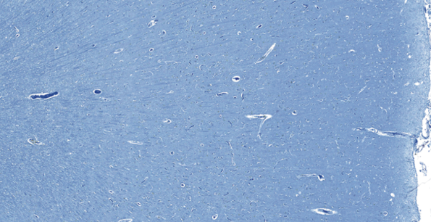
Alzheimer’s disease pathophysiology
Accumulating beta-amyloid (Aβ) & tau
?
Tau pathology
Memory loss
Cortex: AD patient
Cortex: Aβ plaques & Tau tangles
Cortex: Healthy
Clark et al., JAMA, 2011; Brettschneider et al., Nat Rev Neurosci, 2015; Mullard et al., Nat Rev Drug Disc, 2017

Slide 5
Alzheimer‘s disease – A cascade of pathological brain changes
Abnormal
Progression of primary
AD pathology
Amyloid
Dementia
Tau
Reserve & Resilience
Coping with pathology
MCI
Normal
Cognitively
Normal
Time
Adopted from Jack et al., Lancet Neurol, 2013
Jack et al., Lancet Neurol, 2013; Weickenmeier, Jucker et al., J Mech Phys Sol, 2019; Vogels et al., Biol Psych, 2020

Slide 6
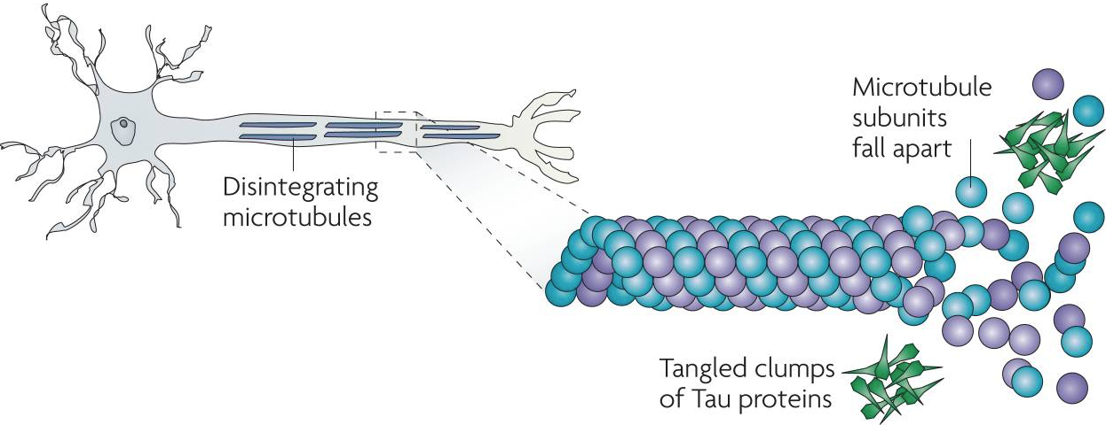
Alzheimer‘s disease – A cascade of pathological brain changes
Diseased neuron
Abnormal
Microtubules
Progression of primary
AD pathology
Degenerating
axon
Amyloid
Tau fibrils/tangles
Dementia
Tau
Reserve & Resilience
Coping with pathology
Tau spreads across connected neurons
MCI
Normal
Cognitively
Normal
Time
Adopted from Jack et al., Lancet Neurol, 2013
Jack et al., Lancet Neurol, 2013; Weickenmeier, Jucker et al., J Mech Phys Sol, 2019; Vogels et al., Biol Psych, 2020

Slide 7
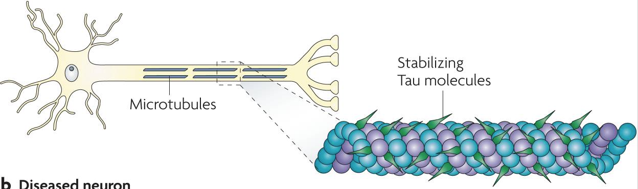
Tau pathology in Alzheimer‘s disease
Stabilizing tau molecules
Brunden et al., Nat Rev Drug Discov, 2010; Vogels et al., Biol Psych, 2020

Slide 8
Tau pathology in Alzheimer‘s disease
Beta-Amyloid
Stabilizing tau molecules
Brunden et al., Nat Rev Drug Discov, 2010; Vogels et al., Biol Psych, 2020

Slide 9
Tau pathology in Alzheimer‘s disease
Beta-Amyloid
Tau propagation across synapses
Alzheimer’s Disease
Microtubules
disintegrate
Stabilizing tau molecules
Degenerating
axon
Tau fibrils/tangles
Tau spreading patterns in Alzheimer’s disease
Brunden et al., Nat Rev Drug Discov, 2010; Vogels et al., Biol Psych, 2020

Slide 10
Tau-PET imaging in Alzheimer‘s disease (AD)
AV1451 Tau-PET
AV1451 Tau-PET in clinical AD variants
Aβ- no symptoms
Aβ+ no symptoms
AD dementia
Schoell et al., Neuron, 2016
Ossenkoppele et al., Brain, 2016
Understanding the development and spread of tau pathology is critical to understand Alzheimer‘s disease progression

Slide 11

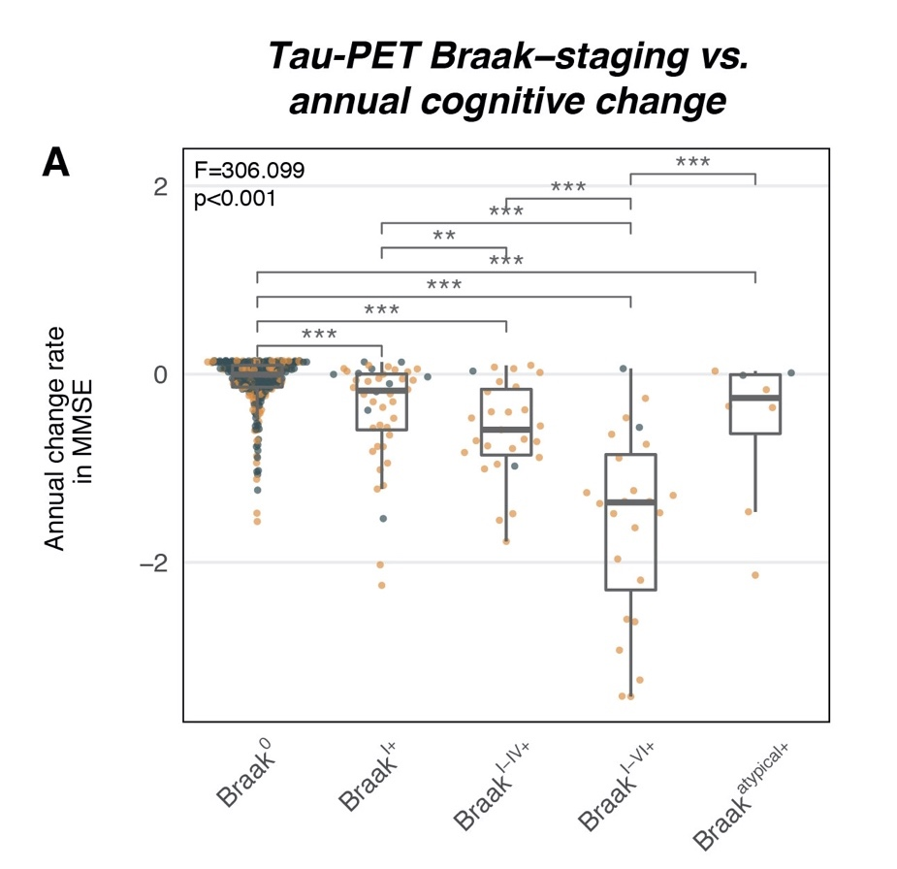
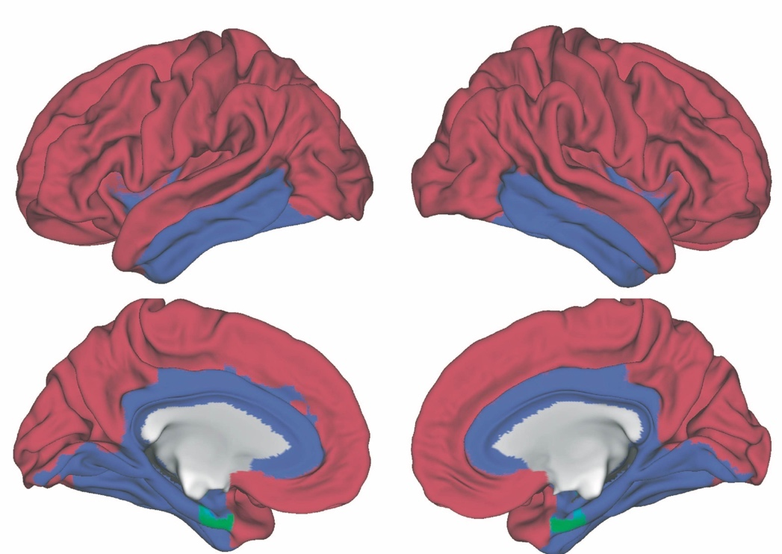
Tau spreading is a key driver of cognitive decline
Post-mortem „Braak-staging“ of tau pathology
Davina Biel
Post-Doc
Neurofibrillary
tangles
In-vivo „Braak-staging“ of tau pathology
Tau-PET imaging
Biel….Franzmeier, Alz Res Ther, 2021

Slide 12
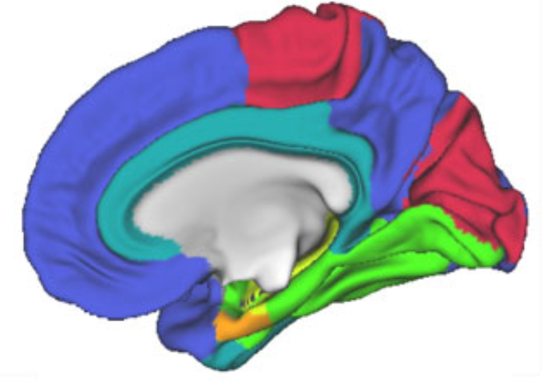
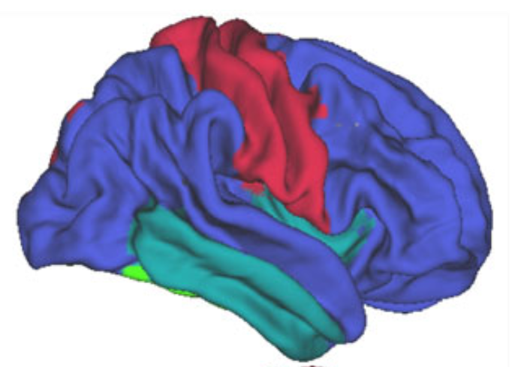
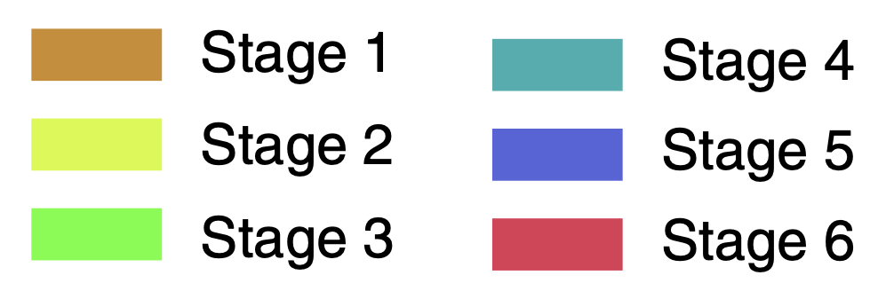
Using connectivity to model tau spreading in AD
Trans-synaptic tau spread
Tau-deposition patterns
Vogels et al., Biol Psych, 2020
Functional connectomics
In vivo tau-PET
Franzmeier et al., Nat Comms, 2019

Slide 13
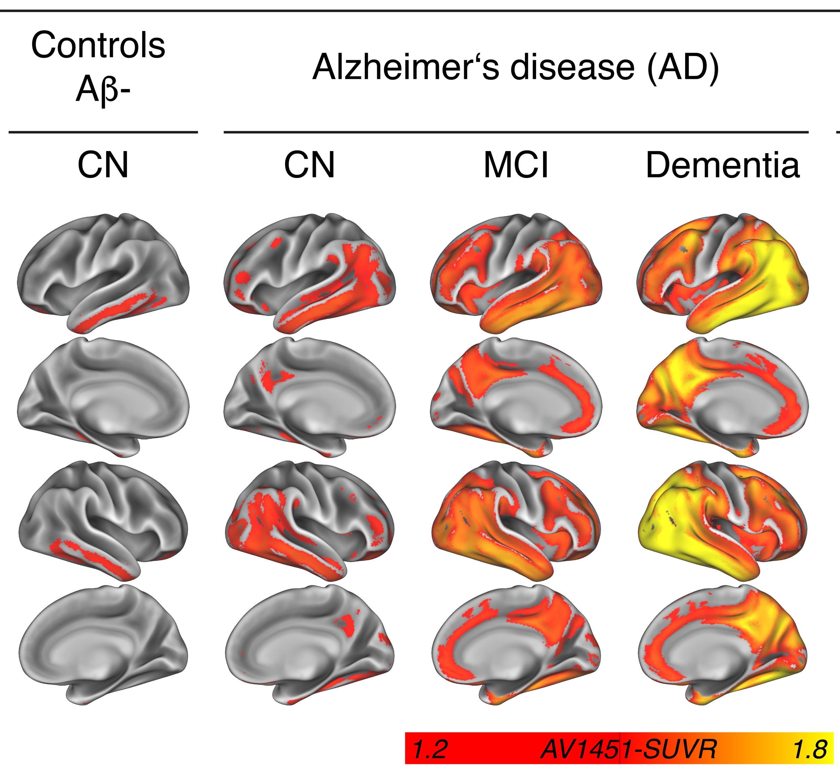
Tau-PET uptake increase across the AD spectrum
Autopsy-based
tau staging
Franzmeier et al., Brain, 2019

Slide 14
Tau-PET uptake increase across the AD spectrum
Autopsy-based
tau staging
Does tau deposition follow the topology of functional brain networks?
Franzmeier et al., Brain, 2019

Slide 15
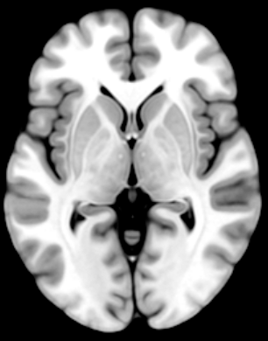
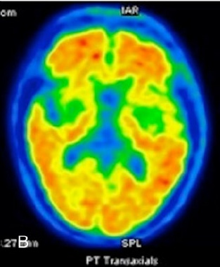
Tau-PET uptake increase across the AD spectrum
Autopsy-based
tau staging
Does tau deposition follow the topology of functional brain networks?
Resting-state fMRI
Tau-PET
Amyloid-PET
Franzmeier et al., Brain, 2019

Slide 16
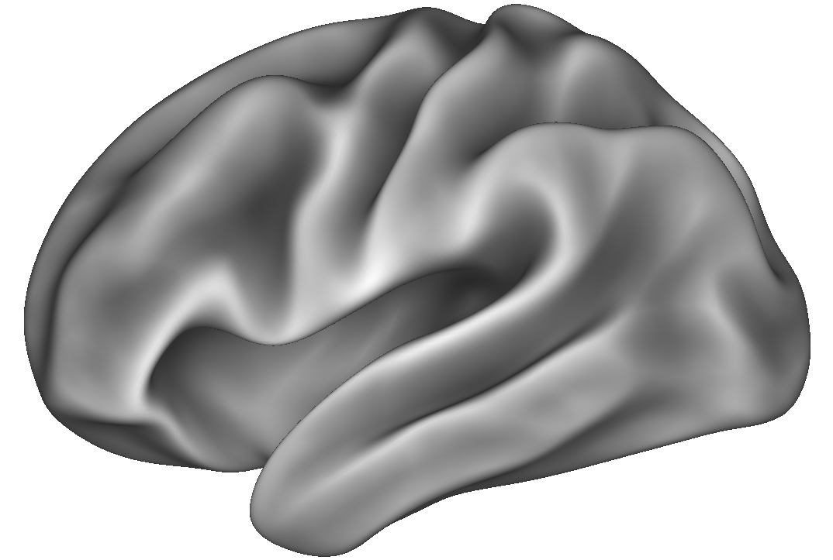
Tau deposition vs. functional connectivity
Hypothesis 1: Functionally connected regions
show covarying tau levels
Hypothesis 2: Regions with high tau are influential
for tau levels in connected regions
High Tau
Step 2:
Assess tau-covariance
Step 2:
Test FC as a predictor of tau
Step 3:
Test association between FC and tau-covariance
Step 1:
Assess resting-state FC
Step 1:
Assess resting-state FC
Low tau
Tau epicenter/hotspot
Franzmeier et al., Brain, 2019

Slide 17
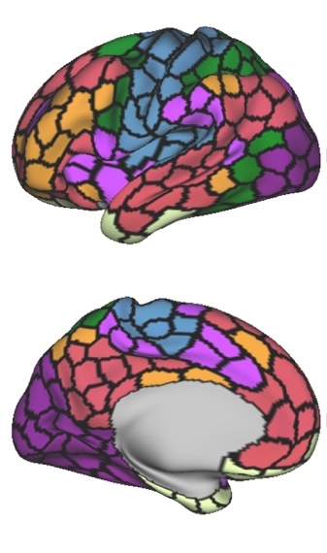
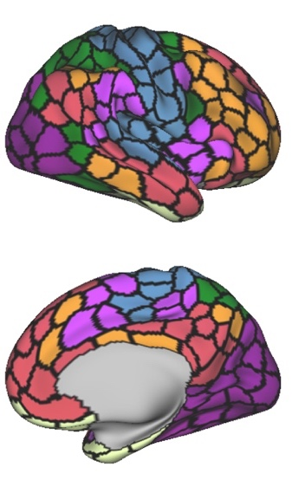
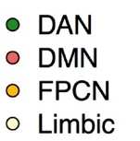
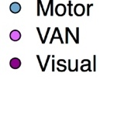
Assessment of functional connectivity
Brain atlas
Networks
Franzmeier et al., Brain, 2019

Slide 18
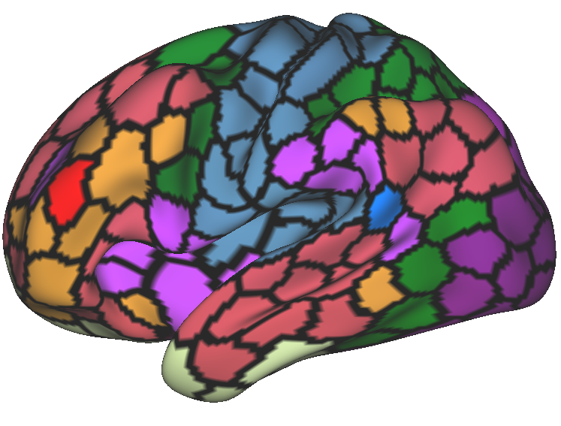
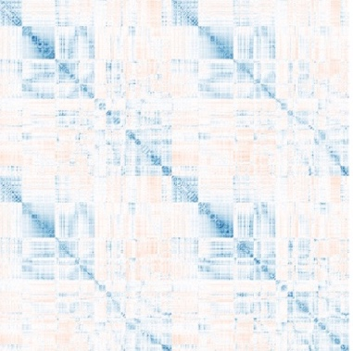
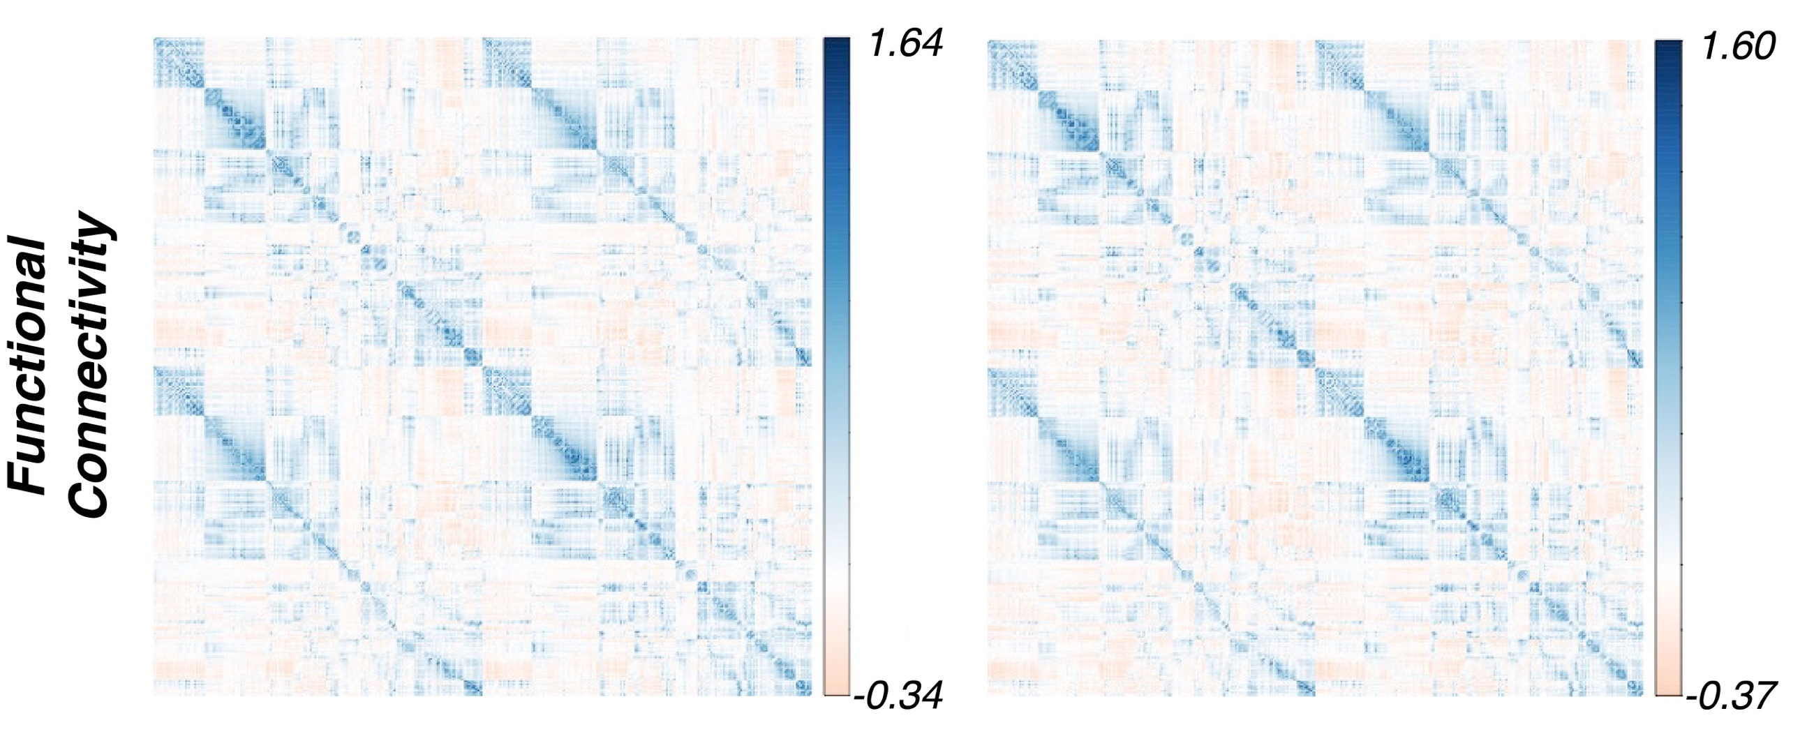
Assessment of functional connectivity
Brain atlas
fMRI data
Assess FC between all ROI pairs
FC matrix
Obtain FC for
each subject
Functional
connectivity
For each subject
Time
Average FC matrices across groups
Cognitively Normal Aβ-
Alzheimer’s disease
Networks
Franzmeier et al., Brain, 2019

Slide 19
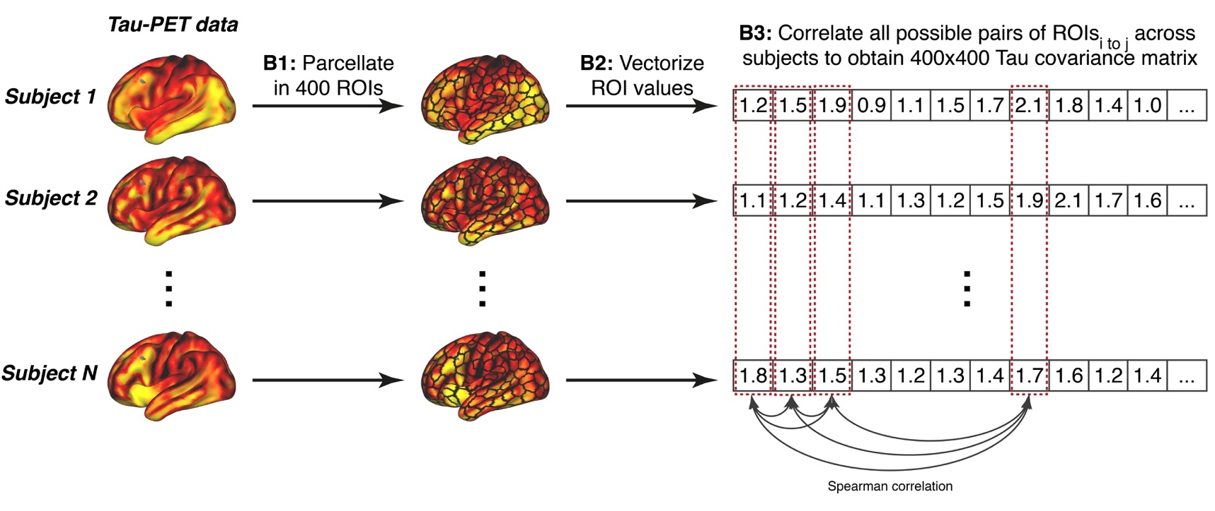
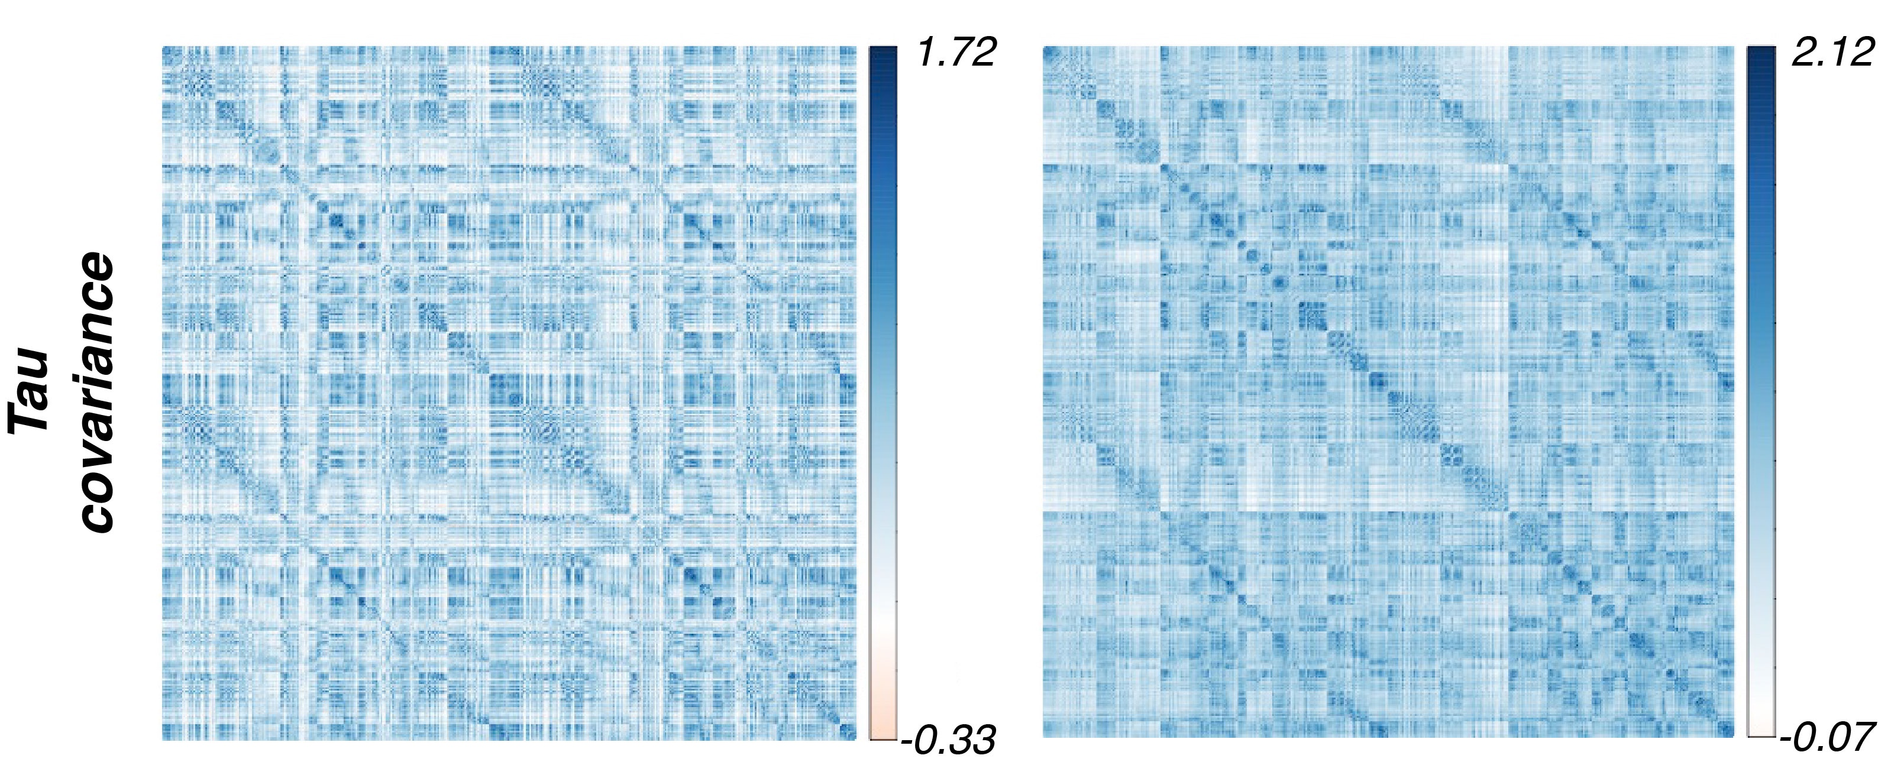
Assessment of tau covariance
Brain atlas
Tau connectivity
Normal aging
Alzheimer’s disease
Networks
Franzmeier et al., Brain, 2019

Slide 20
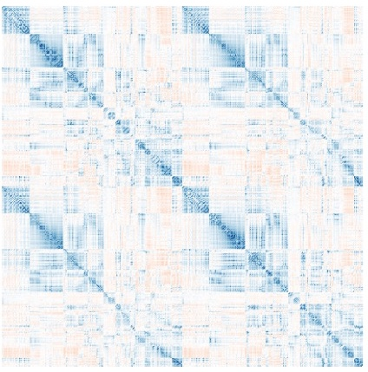
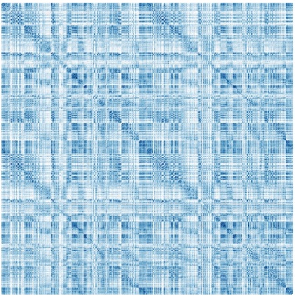
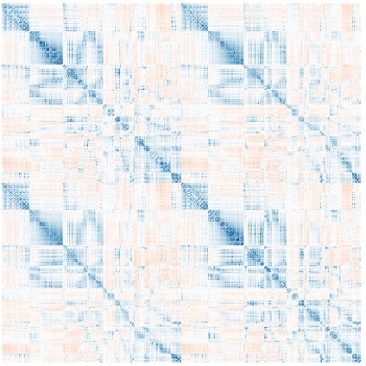
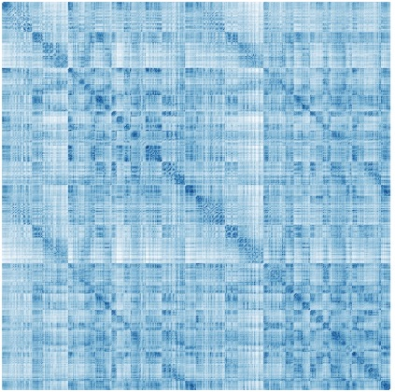
Regions with high functional connectivity show covarying tau levels
Cognitively Normal Aβ-
Alzheimer’s disease
Functional
connectivity
Tau
covariance
Functional
connectivity
Tau
covariance
Cross correlate
Cross correlate
P-values are based on 1000 bootstrapped samples on which functional and tau covariance were iteratively determined
Franzmeier et al., Brain, 2019

Slide 21
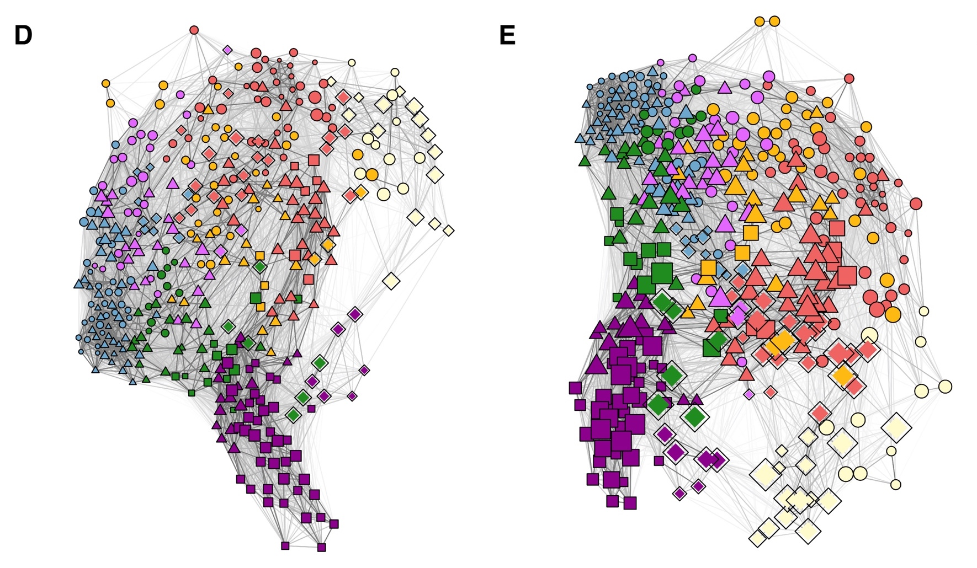
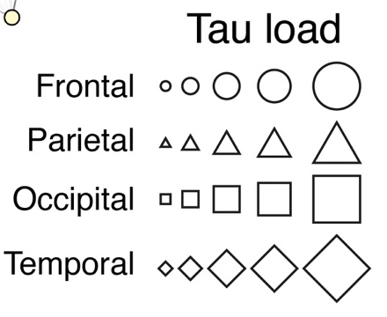
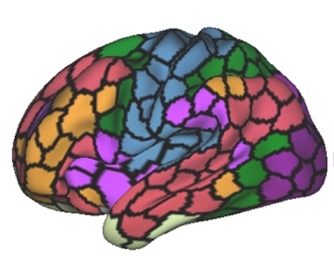
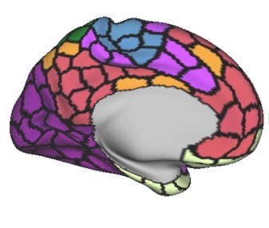
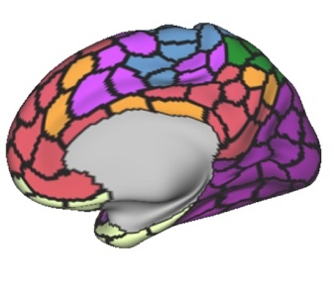
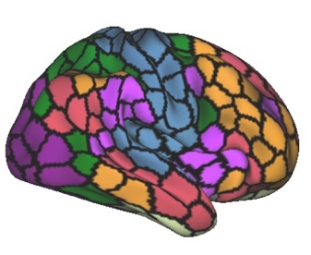
Tau deposition and functional network topology
Cognitively Normal Aβ-
Alzheimer’s disease
Franzmeier et al., Brain, 2019

Slide 22
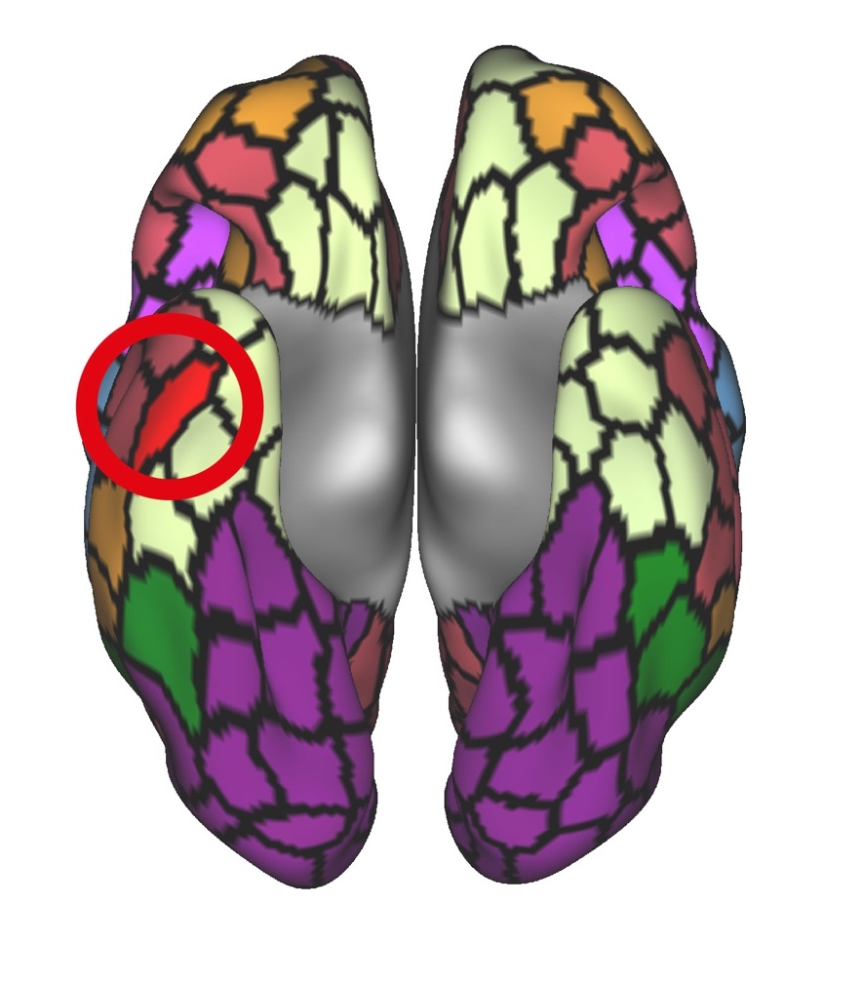
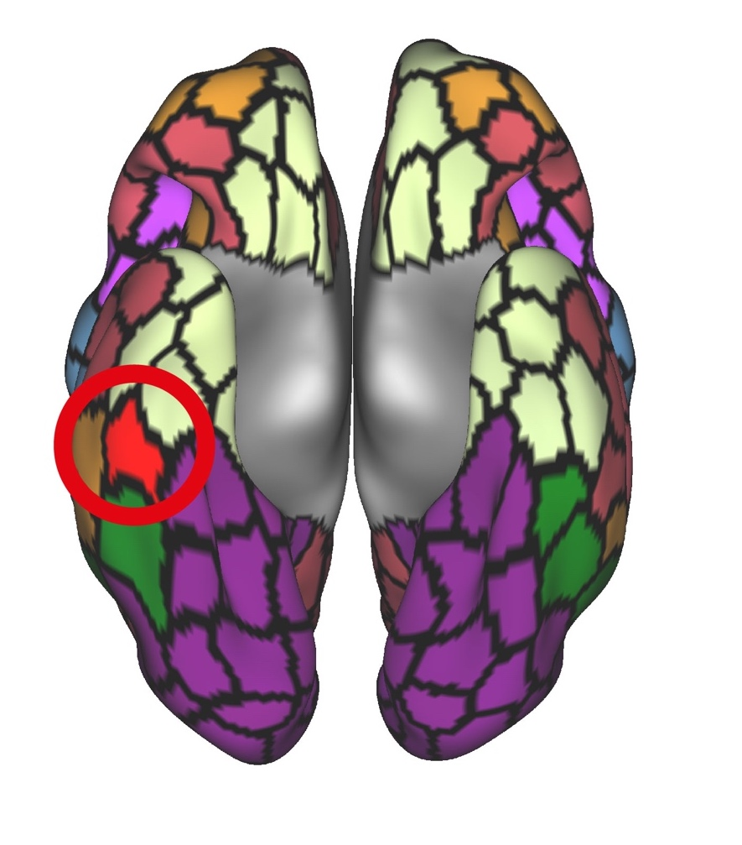
Connectivity of tau-epicenters/hotspots predicts tau deposition patterns
Cognitively Normal Aβ-
Alzheimer’s disease
Franzmeier et al., Brain, 2019

Slide 23
Connectivity of tau-epicenters/hotspots predicts tau deposition patterns
Cognitively Normal Aβ-
Alzheimer’s disease
Major limitation: Cross-sectional study design!
Tau spreading is, however, ideally studied longitudinally!
Franzmeier et al., Brain, 2019

Slide 24
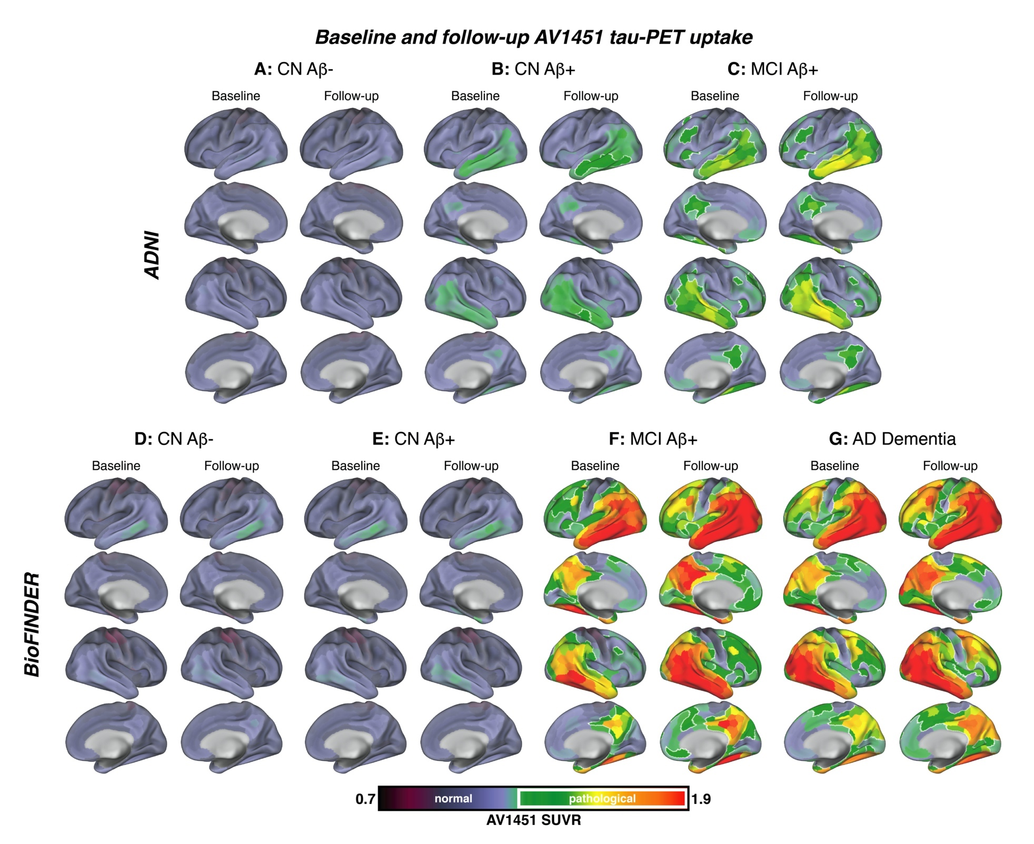
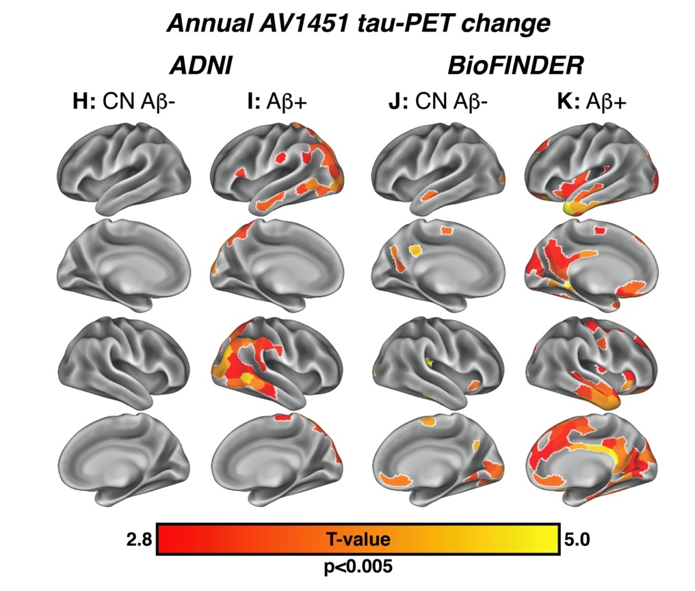
Longitudinal tau-PET imaging in Alzheimer‘s disease
Franzmeier et al., Nat Comms, 2020

Slide 25
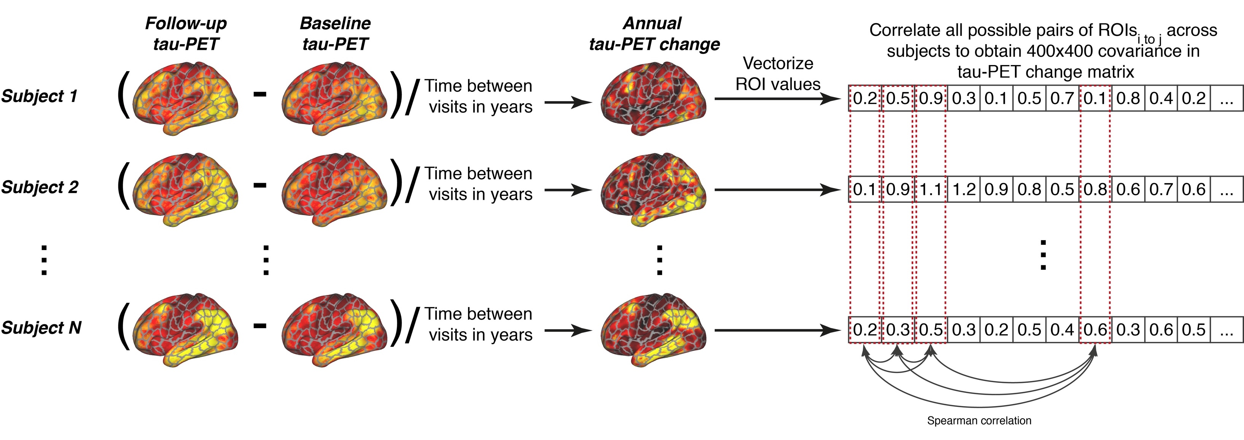
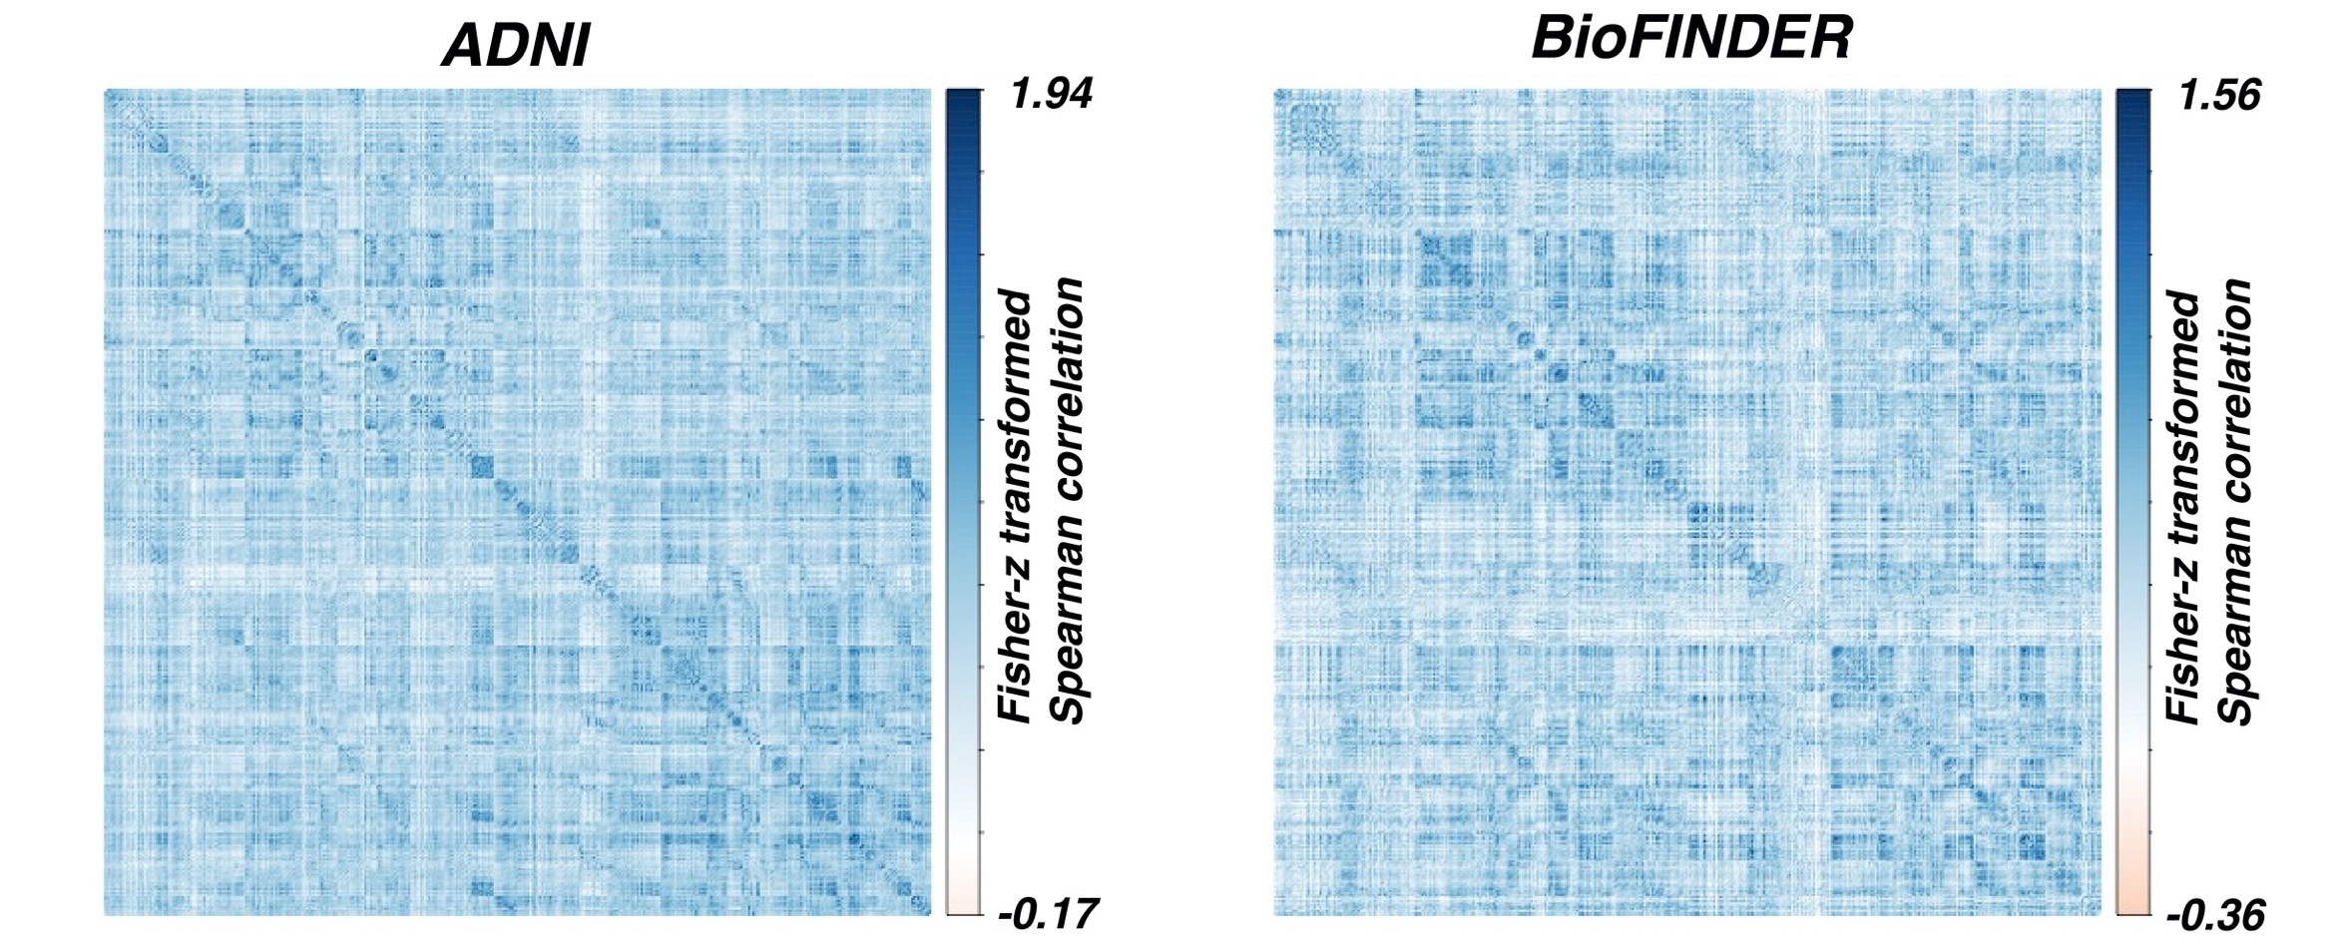
Assessment of covariance in tau change in AD patients
Brain atlas
Covariance in tau
Change matrix in AD
Networks
Franzmeier et al., Nat Comms, 2020

Slide 26
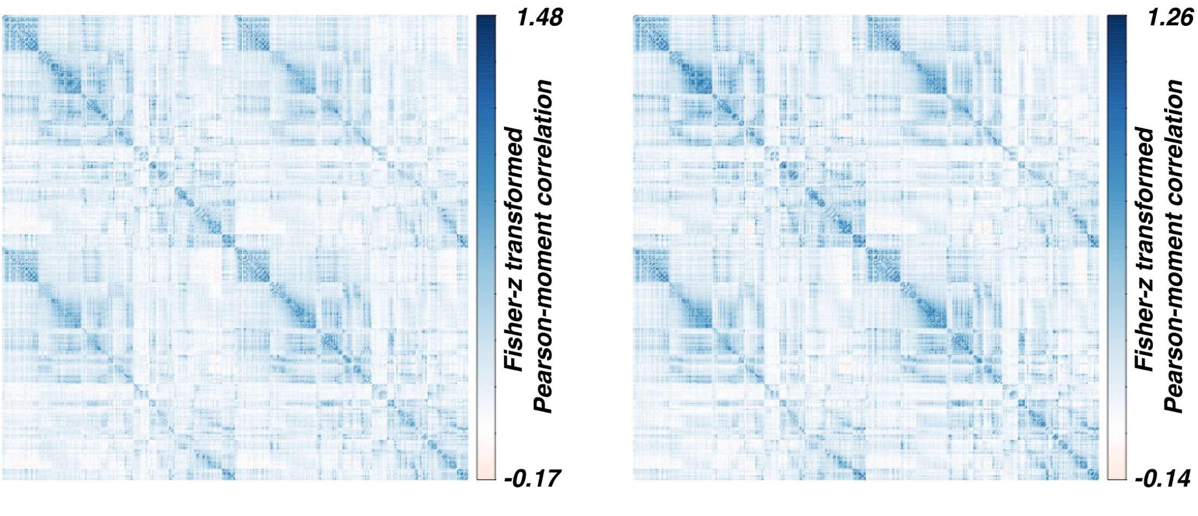
Assessment of functional connectivity
Brain atlas
fMRI data
Assess FC between all ROI pairs
FC matrix
Obtain FC for
each subject
Functional
connectivity
For each subject
Time
Average FC matrices across groups
Normal aging
Alzheimer’s disease
Networks
Franzmeier et al., Nat Comms, 2020

Slide 27
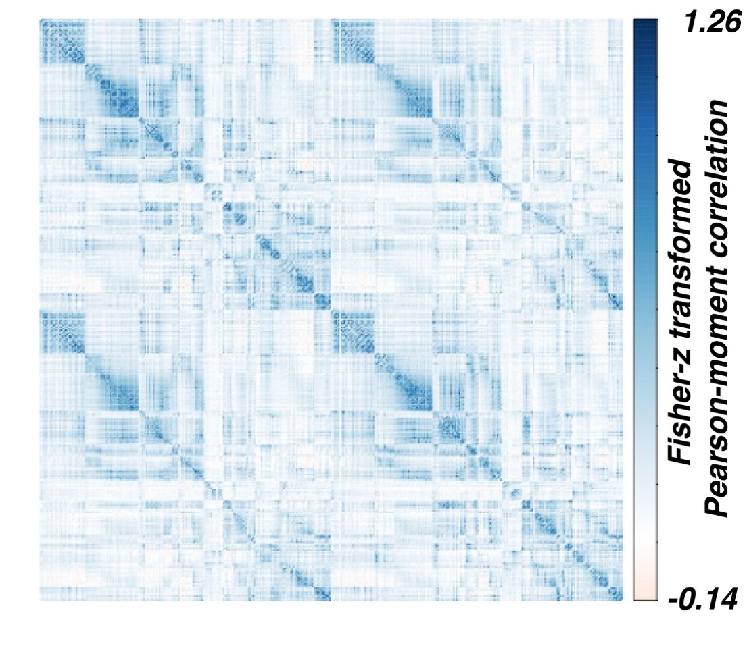
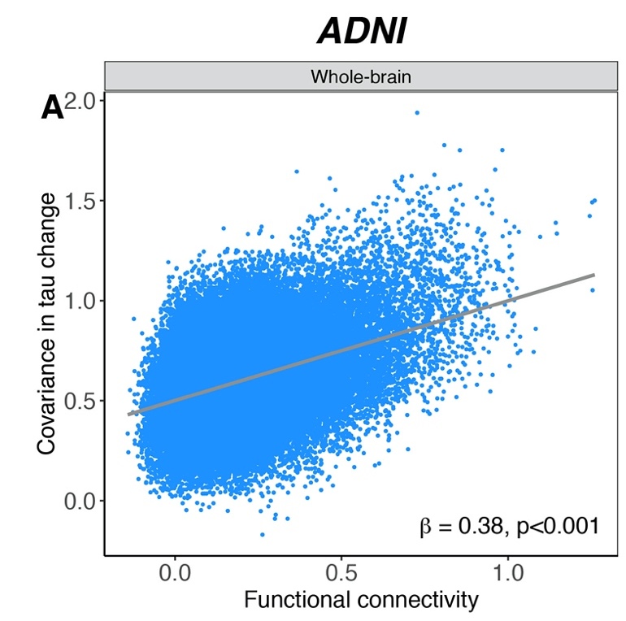
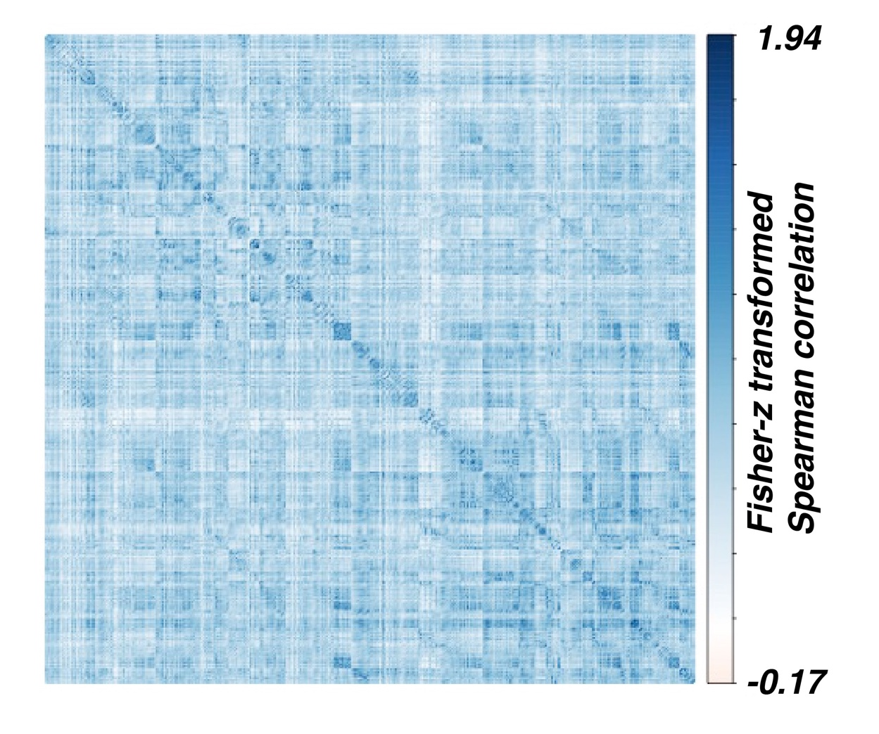
Functionally connected regions show similar tau accumulation rates
Functional connectivity
Association between functional connectivity
and covariance in tau accumulation
Covariance in tau change
Franzmeier et al., Nat Comms, 2020

Slide 28
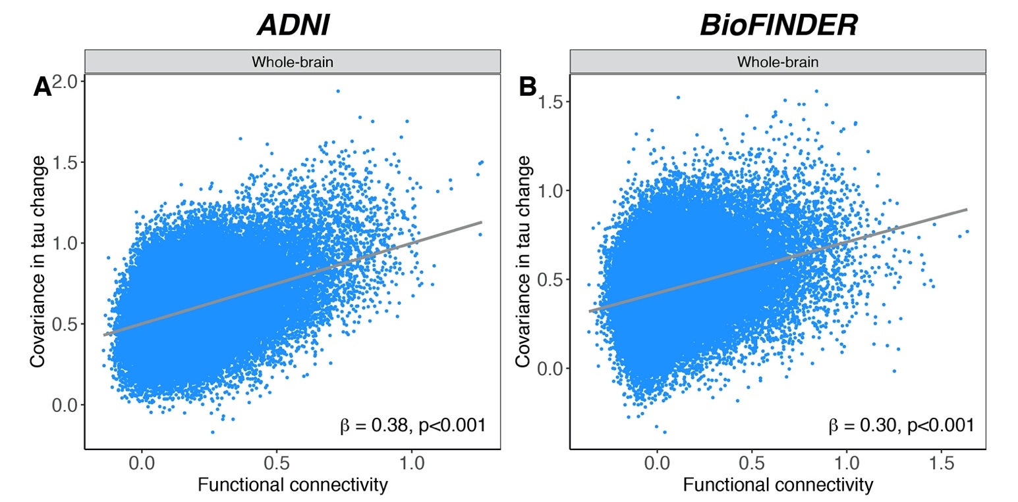
Functionally connected regions show similar tau accumulation rates
Functional connectivity
Association between functional connectivity
and covariance in tau accumulation
Replication
Covariance in tau change
Franzmeier et al., Nat Comms, 2020

Slide 29
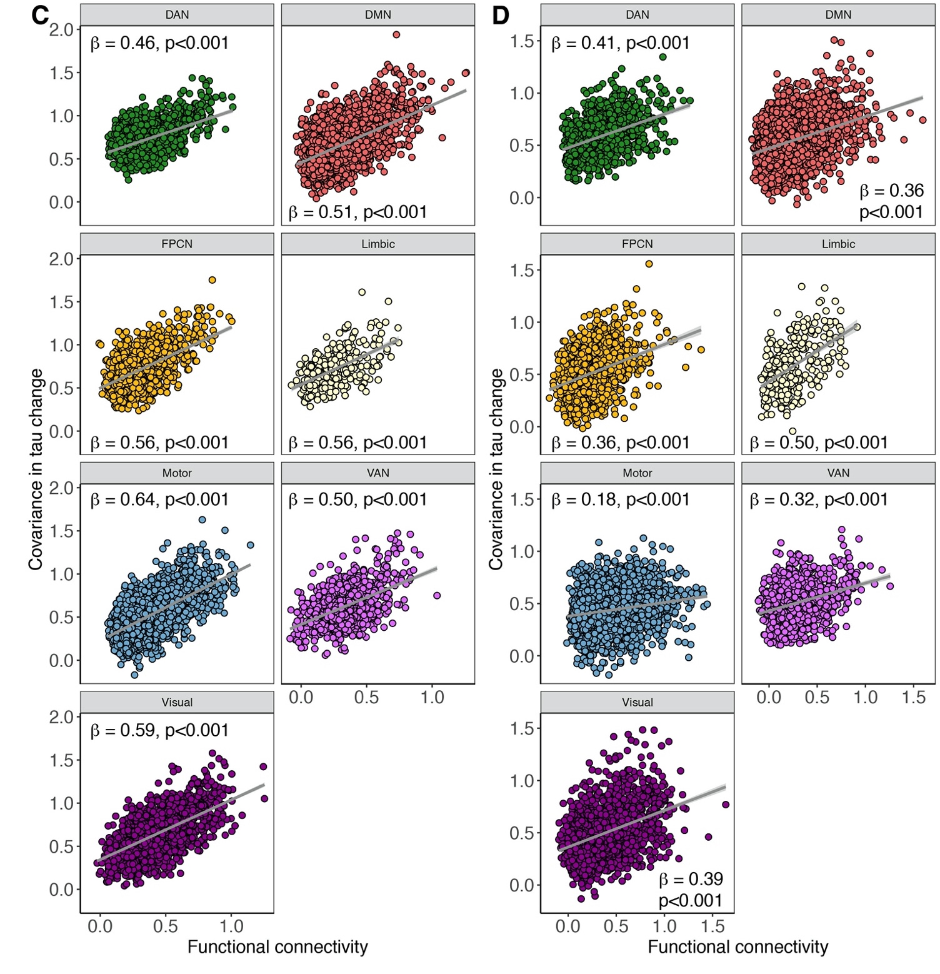
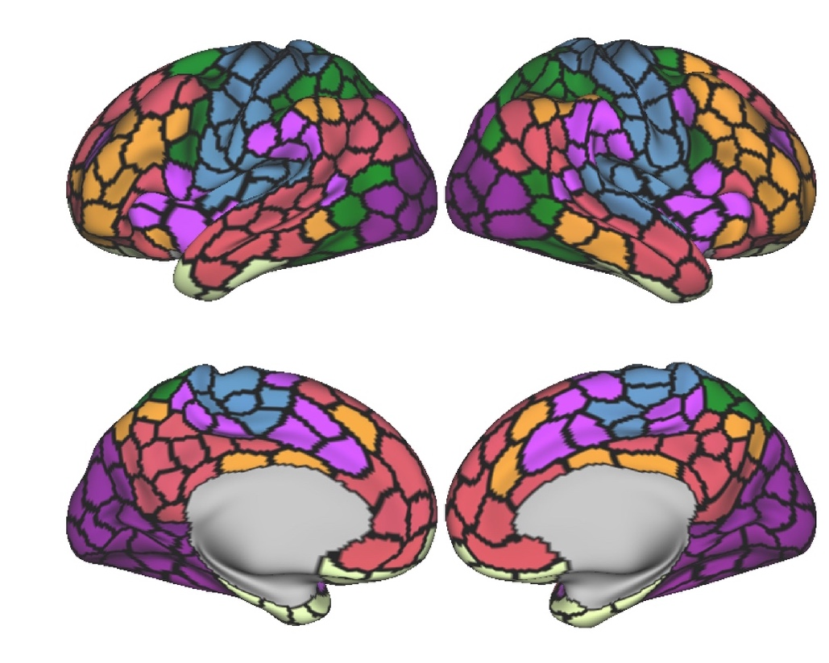
Functionally connected regions show similar tau accumulation rates within brain networks
Brain atlas
Franzmeier et al., Nat Comms, 2020

Slide 30

Regions with high tau/low accumulation are interconnected
Brain atlas
Franzmeier et al., Nat Comms, 2020

Slide 31

Regions with high tau/low accumulation are interconnected
Brain atlas
Franzmeier et al., Nat Comms, 2020

Slide 32

Regions with high tau/low accumulation are interconnected
Brain atlas
Franzmeier et al., Nat Comms, 2020

Slide 33
Regions with high tau/low accumulation are interconnected
Can we use connectivity to model spatially heterogeneous subject level tau spreading patterns?
Brain atlas
Franzmeier et al., Nat Comms, 2020

Slide 34
Connectivity-based modeling of tau spreading
Connectivity-based tau spreading model
Tau epicenter
Disease progression

Slide 35

Connectivity-based modeling of tau spreading
Connectivity-based tau spreading model
Tau epicenter
Disease progression
Group-level (cross-sectional)
Early tau accumulation in AD
Late tau accumulation in AD
Epicenter: 10% of brain regions showing highest and earliest tau-PET across the group

Slide 36


Tau-PET samples: ADNI & BioFINDER
ADNI n=444 cross-sectional n=106 longitudinal | CN-Ab- (n=231) | CN-Ab+ (n=117) | MCI- Ab+ (n=85) | AD Dementia (n=11) | p-value
Age | 72.76±6.98^{b,c} | 76.91±7.49ª | 75.94±7.67ª | 74.36±10.23 | <0.001
Sex (m/f) | 93/138 | 47/70 | 49/36 | 6/5 | 0.030
Education (M/SD) | 16.82±2.41^{c} | 16.44±2.6 | 15.88±2.64ª | 16±2.05 | 0.025
ADAS-global (M/SD) | 12.27±4.55^{c,d} | 13.61±5.41^{c,d} | 23.18±11^{a,b,d} | 32.21±8.26^{a,b,c} | <0.001
Mean tau-PET follow-up time in years (M/SD)¹ | NA | 1.61±0.79 | 1.56±0.71 | 1.44±0.72 | 0.871
BioFINDER n=57 (cross-sectional & longitudinal) | CN-Ab- (n=16) | CN-Ab+ (n=16) | MCI- Ab+ (n=7) | AD Dementia (n=18) | p-value
Age | 73.88 (5.32) | 75.44 (6.09) | 72.71 (6.63) | 69.83 (10.48) | 0.192
Sex (m/f) | 10/6 | 6/10 | 2/5 | 11/7 | 0.245
Education (M/SD) | 12.59 (4.06) | 10.56 (3.22) | 11.14 (2.67) | 13.44 (3.26) | 0.097
MMSE (M/SD) | 29 (1.1)^{d} | 29.31 (1.08)^{d} | 25.57 (2.94) | 22.06 (5.17)^{a,b} | <0.001
Mean tau-PET follow-up time in years (M/SD) | 2.03 (0.47) | 1.91 (0.32) | 1.82 (0.12) | 1.97 (0.34) | 0.484
1=subsample of 61 CN Ab+, 40 MCI Ab+, 5 AD Dementia
Tau-PET
(AV1451, longitudinal)
Amyloid-PET
Resting-state fMRI sample: Human Connectome Project (N=1000)
Brain atlas

Slide 37

Minimizing off-target binding effects: Transforming Tau-SUVRs to tau positivity probabilities
Franzmeier et al., Science Advances, 2020

Slide 38


Modeling group-level tau spreading patterns
Subjects
Early
tau accumulation
Late
tau accumulation
Early
tau accumulation
Subjects
Late
tau accumulation
ROIs
Epicenters
Franzmeier et al., Science Advances, 2020

Slide 39

Modeling group-level tau spreading patterns
Subjects
Early
tau accumulation
Late
tau accumulation
Early
tau accumulation
Subjects
Late
tau accumulation
ROIs
Epicenters
Franzmeier et al., Science Advances, 2020

Slide 40

Modeling group-level tau spreading patterns
High heterogeneity across subjects
=> ICA-based decomposition in tau patterns
Subjects
Subjects
ROIs
Epicenters
Franzmeier et al., Science Advances, 2020

Slide 41

ICA-based decomposition of tau deposition patterns
Group-level
tau-PET data (ADNI)
Independent component Analysis (ICA)
Franzmeier et al., Science Advances, 2020

Slide 42

ICA-based decomposition of tau deposition patterns
Group-level
tau-PET data (ADNI)
Independent component Analysis (ICA)
Assign subjects to components
Franzmeier et al., Science Advances, 2020

Slide 43







Modeling tau spreading patterns in ICA-derived tau subtypes
Occipito-temporal tau-subtype:
Group-level tau-PET
Cross-sectionally estimated tau-spreading
Sliding-window analyses of tau-PET
Connectivity-based modeling of tau spreading
Franzmeier et al., Science Advances, 2020

Slide 44






Modeling tau spreading patterns in ICA-derived tau subtypes
Parietal tau-subtype:
Group-level tau-PET
Cross-sectionally estimated tau-spreading
Sliding-window analyses of tau-PET
Connectivity-based modeling of tau spreading
Franzmeier et al., Science Advances, 2020

Slide 45

Cross-sectional Tau spreading in ICA-derived tau-subtypes
Neocortical tau-subtype:
Group-level tau-PET
Cross-sectionally estimated tau-spreading
Subtype-specific tau spreading sequences better capture subject-level tau deposition patterns
Sliding-window analyses of tau-PET
Connectivity-based modeling of tau spreading
Franzmeier et al., Science Advances, 2020

Slide 46

Connectivity-based tau spreading
Connectivity-based tau spreading model
Tau epicenter
Disease progression
Subject-level (longitudinal)
Epicenter: 10% of brain regions showing highest baseline tau-PET within a given subject
Franzmeier et al., Science Advances, 2020

Slide 47


Subject-specific modeling of tau spreading in AD
Tau epicenter (patient-specific)
ADNI
BioFinder
Fastest tau accumulation in regions closely connected to tau epicenters
Franzmeier et al., Science Advances, 2020

Slide 48

Subject-specific modeling of tau spreading in AD
Tau epicenter (patient-specific)
ADNI
BioFinder
Q1 is more sensitive to detect and quantify tau accumulation than conventional approaches
Franzmeier et al., Science Advances, 2020

Slide 49



Tau-PET as an endpoint in clinical trials
What is the most sensitive way to quantify whether an intervention affects the spread of tau?
Biogen, Aducanumab Topline Results; Franzmeier et al., Science Advances, 2020

Slide 50

Do highly interconnected brain hubs facilitate the spread of tau?
Globally connected
hubs
Frontzkowski…Franzmeier, under review

Slide 51
Do highly interconnected brain hubs facilitate the spread of tau?
Globally connected
hubs
Tau
pathology
Frontzkowski…Franzmeier, under review

Slide 52
Do highly interconnected brain hubs facilitate the spread of tau?
Globally connected
hubs
Tau
pathology
R = 6
Frontzkowski…Franzmeier, under review

Slide 53
Do highly interconnected brain hubs facilitate the spread of tau?
Globally connected
hubs
Tau
pathology
R = 6
Tau
pathology
Frontzkowski…Franzmeier, under review

Slide 54



Do highly interconnected brain hubs facilitate the spread of tau?
Patient X
Patient Y
Globally connected
hubs
Tau-PET gradient
Lukas Frontzkowski
MD Student
Tau in non-hubs
Tau in hubs
β=0.54
p<0.001
Tau
pathology
R = 6
R = 2
Tau
pathology
Frontzkowski…Franzmeier, under review

Slide 55
Summary – Tau spreading
Tau epicenter
Tau spreading patterns can be predicted by connectivity
For Braak-like spreading patterns
For non-Braak like spreading patterns
Connectivity-based models of tau spreading can
Predict where in the brain tau will most likely accumulate in the future on the patient level
Help define patient-tailored tau-PET readouts in trials that use tau as an endpoint to reduce sample sizes

Slide 56
BIN1 – A genetic risk factor for developing tau pathology

Slide 57

Alzheimer‘s disease genetic risk factors
AD has a heritability of up to 60% (twin-studies)
Strong genetic component
GWAS-based identification of AD genetic
Risk variants
Bridging Integrator 1 (BIN1) is one of the most
important risk-loci for late onset AD after APOE
Alzgene.org, Robinson et al., J Alz Dis, 2017; Cuyvers & Sleegers, Lancet Neurol, 2016; Gatz et al., Jama Psychiatry, 2006

Slide 58

BIN1 involvement in AD pathophysiology
Neuronal BIN1 (isoform 1) modulates endocytosis of tau in-vitro
Tau spread is partly endocytosis
dependent
Hypothesis: BIN1 specifically modulates tau pathology
Evans et al., Cell Rep., 2018, Calafate et al., Cell Rep, 2016; Holler et al., J Alz Dis, 2014

Slide 59


BIN1 rs744373 risk-allele carriage is associated with stronger tau pathology
Compare tau load between rs744373 risk and normal carriers
Are regions with high BIN1 expression especially vulnerable to tau
ANCOVAs controlled for age, gender,
education, amyloid and ApoE ε4-status
Franzmeier et al, Nat Comms, 2019

Slide 60






Associations between regional BIN1 mRNA expression and tau pathology
89 Individual tau-PET images
Allen brain atlas
Regions with higher BIN1 expression have a higher likelihood of showing higher tau pathology
Cross-correlate
p<0.001
Distribution of tau pathology
Group median tau-PET
uptake in the ADNI sample
BIN1 mRNA expression
10 000 bootstrapped correlation analyses
(iteratively determined group median tau)
Control analysis: No associations between tau and ACTB expression
Franzmeier et al, Nat Comms, 2019

Slide 61


Associations between BIN1 rs744373 risk-allele carriage and amyloid
Compare amyloid load between rs744373 risk and normal carriers
ANCOVAs controlled for age, gender,
education and ApoE ε4-status
Franzmeier et al, Nat Comms, 2019

Slide 62

BIN1 rs744373 in the context of the amyloid cascade
Gradual deposition of Aβ plaques
Development of tau tangles
BIN1 rs744373
Cognitive Decline and Dementia
GWAS
Are effects of BIN1 rs744373 on cognition mediated via tau?
Linear regression controlled for age,
gender, education and ApoE ε4-status
Franzmeier et al, Nat Comms, 2019

Slide 63
BIN1 risk allele carriage is associated with impaired memory
β=-0.25 (0.11), p<0.05
BIN1 rs744373 risk allele
carriage
Memory performance (ADNI-MEM memory composite)
Franzmeier et al, Nat Comms, 2019

Slide 64

BIN1-related risk for cognitive impairment is mediated via tau pathology
Global tau-PET uptake
β=-0.13 (0.06), p<0.05
β=0.64 (0.19), p<0.05
β=-0.08 [-0.18;0], p<0.05
β=-0.17 (0.11), n.s.
BIN1 rs744373 risk allele
carriage
Memory performance (ADNI-MEM memory composite)
Franzmeier et al, Nat Comms, 2019

Slide 65
BIN1 Summary
The BIN1 rs733474 SNP is associated with higher tau pathology independent of amyloid
Regions with high BIN1 mRNA expression are more likely to harbor tau pathology
Effects of BIN1 rs744373 on memory are mediated via tau
Future questions:
Could BIN1 be used as a therapeutic target for tau?
Gradual deposition of Aβ plaques
BIN1 rs744373
Development of tau tangles
Cognitive Decline and Dementia

Slide 66
Overall summary: Understanding determinants and mechanisms of tau spreading
Connectomics
PET-imaging
Genetics
Tau pathology spreads across connected brain regions
Tau accumulation can be predicted by connectivity models which helps overcome the limitations by classical staging models (e.g. Braak staging) => potentially useful for trials
Genetic risk factors (e.g. BIN1) may specifically promote the deposition and spread of tau pathology => may help define new treatment targets

Slide 67
Acknowledgements
Ewers Lab
Michael Ewers
Anna Rubinski
Julia Neitzel
Lukas Frontzkowski
Ying Luan
Lund University
Oskar Hansson
Olof Strandberg
Ruben Smith
VUMC Amsterdam
Rik Ossenkoppele
ISD
Marco Duering
Martin Dichgans
Katharina Bürger
UCSF/ADNI
Michael Weiner
LMU
Christian Haass
Matthias Brendel
Marc Suarez-Calvet

